Slide 1

Unit II – Advanced Trees
BRACT’S, Vishwakarma Institute of Information Technology, Pune-48
(An Autonomous Institute affiliated to Savitribai Phule Pune University)
(NBA and NAAC accredited, ISO 9001:2015 certified)
Advanced Data Structures
Ms. Devika Verma
Computer Eng. Dept., VIIT, Pune

Slide 2
Contents
Threaded binary tree
In-order traversal of in-order threaded binary tree.
AVL Trees
Indexing and Multiway Search Trees
B-Tree, B+Tree
Splay Tree
Red Black Tree
Trie Tree

Slide 3
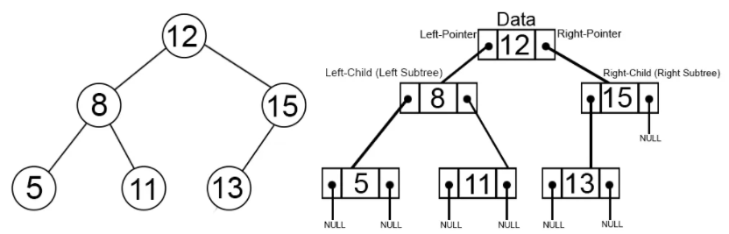
Threaded BINARY Trees
Binary trees have a lot of wasted space: the leaf nodes each have 2 null pointers
We can generalize it that for any binary tree with n nodes there will be (n+1) null pointers and 2n total pointers
We can use these pointers to help us in traversals??

Slide 4
Threaded BINARY Trees
A. J. perils & C. Thornton jointly proposed idea to make effective use of these null pointers.
Main Idea: To use null pointers to make the inorder and preorder traversal of the tree faster without using any additional data structure(e.g auxilary stack) or memory to do the traversal
Null pointers of leaf node of the binary tree is set to inorder predecessor or inorder successor.

Slide 5
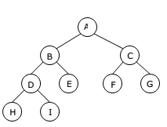
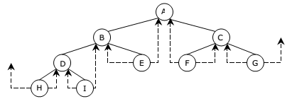
TBT EXAMPLE
Binary Tree and its corresponding to threaded binary tree
The tree has 9 nodes and 10 null links which have been replaced by threads.
If we traverse the tree in in-order the nodes will be visited in the order H D I B E A F C G
For Example, node E has predecessor thread which points to node B and successor thread which points to node A

Slide 6
Threaded BINARY Trees
To differentiate between pointer to child and pointer to inorder successor / predecessor the node structure of the binary tree is updated
Two extra one bit fields LBIT and RBIT are added
If LBIT=0 , LEFT is pointer to left child, else to inorder predecessor
If RBIT=0, RIGHT is pointer to right child, else to inorder successsor
Data
LBIT
LEFT
DATA
RIGHT
RBIT

Slide 7
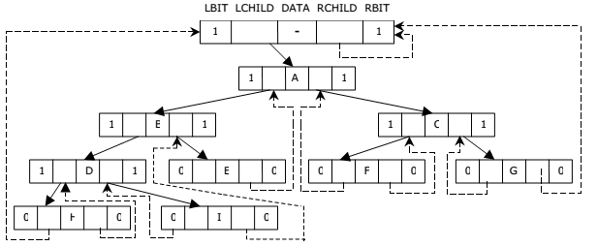
Threaded BINARY Trees
In order to have no loose threads we assume a head node in implementation of TBT.
The tree T is left sub tree of the dummy/head node
Complete memory representation of TBT

Slide 8
TBT NODE
Example code:
class Node {
type data
Node left, right;
boolean lbit, rbit;
}

Slide 9
Threaded Tree Example
6
8
3
1
5
7
11
9
13

Slide 10
TBT In-ORDER Traversal
We start at the leftmost node in the tree, print it, and follow its right thread
If we follow a thread to the right, we output the node and continue to its right
If we follow a link to the right, we go to the leftmost node, print it, and continue

Slide 11
Threaded Tree Traversal
Output
1
6
8
3
1
5
7
11
9
13
Start at leftmost node, print it

Slide 12
Threaded Tree Traversal
Output
1
3
6
8
3
1
5
7
11
9
13
Follow thread to right, print node

Slide 13
Threaded Tree Traversal
Output
1
3
5
6
8
3
1
5
7
11
9
13
Follow link to right, go to leftmost node and print

Slide 14
Threaded Tree Traversal
Output
1
3
5
6
6
8
3
1
5
7
11
9
13
Follow thread to right, print node

Slide 15
Threaded Tree Traversal
Output
1
3
5
6
7
6
8
3
1
5
7
11
9
13
Follow link to right, go to leftmost node and print

Slide 16
Threaded Tree Traversal
Output
1
3
5
6
7
8
6
8
3
1
5
7
11
9
13
Follow thread to right, print node

Slide 17
Threaded Tree Traversal
Output
1
3
5
6
7
8
9
6
8
3
1
5
7
11
9
13
Follow link to right, go to leftmost node and print

Slide 18
Threaded Tree Traversal
Output
1
3
5
6
7
8
9
11
6
8
3
1
5
7
11
9
13
Follow thread to right, print node

Slide 19
Threaded Tree Traversal
Output
1
3
5
6
7
8
9
11
13
6
8
3
1
5
7
11
9
13
Follow link to right, go to leftmost node and print

Slide 20
Threaded Tree Traversal Code
Node leftMost(Node n)
{
Node ans = n;
if (ans == null)
return null;
while (ans.left != null)
ans = ans.left;
return ans;
}
void inOrder(Node n)
{
Node cur = leftmost(n);
while (cur != null)
{
print(cur);
if (cur.rbit)
cur = cur.right;
else
cur = leftmost(cur.right);
}
}
}

Slide 21
Threaded Tree Modification
We’re still wasting pointers, since half of our leafs’ pointers are still null
We can add threads to the previous node in an inorder traversal as well, which we can use to traverse the tree backwards or even to do postorder traversals

Slide 22
Threaded Tree Modification
6
8
3
1
5
7
11
9
13

Slide 23
TYPES OF TBT
Single Threaded Binary Tree
Double Threaded Binary Tree
Here only the right NULL pointer are made to point to inorder successor.
Here both the right as well as the left NULL pointers are made to point inorder successor and inorder predecessor respectively. (here the left threads are helpful in reverse inorder traveral of the tree )

Slide 24
TYPES OF TBT
// single threaded
Class Node{
int data ;
Node *left ;
Node *right ;
bool rightThread ;
}
// double threaded
Class Node{
int data ;
Node *left ;
Node *right ;
bool leftThread ;
bool rightThread ;
}

Slide 25
TYPES OF TBT
// single threaded
Class Node{
int data ;
Node *left ;
Node *right ;
bool rightThread ;
}
// double threaded
Class Node{
int data ;
Node *left ;
Node *right ;
bool leftThread ;
bool rightThread ;
}

Slide 26
Creation of SINGLE TBT
static Node createThreaded(Node root)
{
if (root == null) // Base cases : Tree is empty or has single node
return null;
if (root.left == null && root.right == null)
return root;
if (root.left != null) // Find predecessor if it exists
{
Node l = createThreaded(root.left); // Find predecessor of root //(Rightmost child in left subtree)
l.right = root; // Link a thread from predecessor to root.
l.rbit = true;
}
if (root.right == null) // If current node is rightmost child
return root;
return createThreaded(root.right); // Recur for right subtree.
}

Slide 27
To Be DISCUSSED
Threaded binary tree
In-order traversal of in-order threaded binary tree.
AVL Trees
Indexing and Multiway Trees
Search tree
B-Tree, B+Tree
Splay Tree
Red Black Tree
Trie Tree

Slide 28
AVL TREES - introduction
BST all operations time is proportional to height of tree O(h)
Height of BST = log(n) where n is number of nodes in BST
Operations can be extended to O(n) time if the BST becomes skewed (i.e. worst case).
By limiting this height to log n, AVL tree imposes an upper bound on each operation to be O(log n) where n is the number of nodes.
AVL Trees - invented by GM Adelson - Velsky and EM Landis in 1962

Slide 29
AVL TREES - INTRODUCTION
AVL is height balanced binary search tree in which each node is associated with a balance factor
Balance Factor (k) = height (left(k)) - height (right(k))
Tree is said to be balanced if balance factor of each node is in between -1 to 1, otherwise, the tree will be unbalanced and need to be balanced.

Slide 30
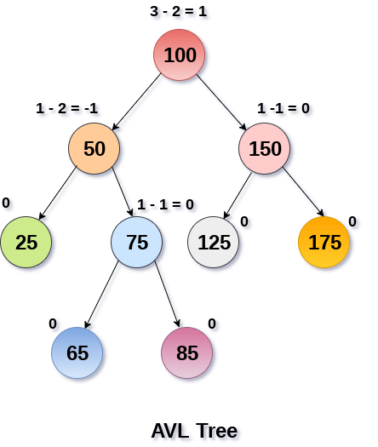
AVL TREE EXAMPLE

Slide 31
AVL TREES - OPERATIONS
AVL tree is also a BST therefore, all the operations are performed in the same way as BST
Searching and traversing do not lead to the violation in property of AVL tree.
However, insertion and deletion may violate AVL property hence need ROTATION OPERATION

Slide 32
AVL TREES - ROTATIONS
We perform rotation in AVL tree only in case if Balance Factor is other than -1, 0, and 1.
Suppose node A is the node whose balance Factor is other than -1, 0, 1. There are four types of rotations:
L L rotation: Inserted node is in the left subtree of left subtree of A
R R rotation : Inserted node is in the right subtree of right subtree of A
L R rotation : Inserted node is in the right subtree of left subtree of A
R L rotation : Inserted node is in the left subtree of right subtree of A

Slide 33
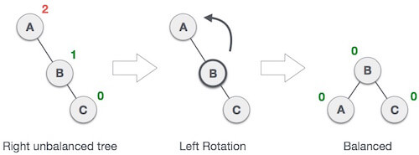
RR - ROTATION
When BST becomes unbalanced, due to a node is inserted into the right subtree of the right subtree of A, then we perform RR rotation
RR rotation is an anticlockwise rotation
It is applied on the edge below a node having balance factor -2

Slide 34
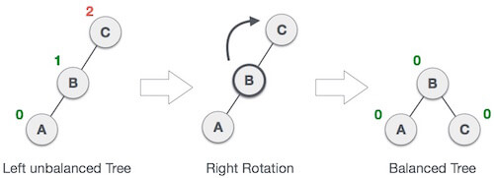
LL - ROTATION
When BST becomes unbalanced, due to a node is inserted into the left subtree of the left subtree of C, then we perform LL rotation
LL rotation is clockwise rotation
It is applied on the edge below a node having balance factor 2.

Slide 35

LR - ROTATION
When BST becomes unbalanced, due to a node is inserted into the right (part) subtree of the left subtree of C, then we perform LR rotation
LR rotation = RR rotation + LL rotation
First RR rotation is performed on subtree and then LL rotation is performed on full tree, by full tree we mean the first node from the path of inserted node whose balance factor is other than -1, 0, or 1.

Slide 36
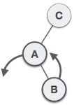
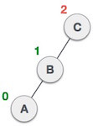
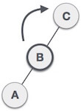
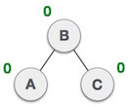
LR - ROTATION
 | 1) Node B has been inserted into the right subtree of A the left subtree of C, because of which C has become an unbalanced node having balance factor 2. This case is L R rotation
 | 2) As LR rotation = RR + LL rotation, hence RR (anticlockwise) on subtree rooted at A is performed first. By doing RR rotation, node A, has become the left subtree of B.
 | 3) After performing RR rotation, node C is still unbalanced, i.e., having balance factor 2, as inserted node A is in the left of left of C
 | 4) Now we perform LL clockwise rotation on full tree, i.e. on node C.
 | 5) Node C has now become the right subtree of node B, A is left subtree of B. Balance factor of each node is now either -1, 0, or 1, i.e. BST is balanced now
1)
2)
3)
4)
5)

Slide 37

RL - ROTATION
When BST becomes unbalanced, due to a node is inserted into the left (part) subtree of the right subtree of C, then we perform RL rotation
RL rotation = LL rotation + RR rotation
First LL rotation is performed on subtree and then RR rotation is performed on full tree, by full tree we mean the first node from the path of inserted node whose balance factor is other than -1, 0, or 1.

Slide 38
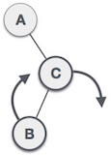
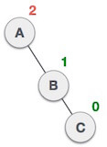
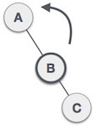
RL - ROTATION
 | 1) node B has been inserted into the left subtree of C the right subtree of A, because of which A has become an unbalanced node having balance factor - 2. This case is RL rotation
 | 2) As RL rotation = LL rotation + RR rotation, hence, LL (clockwise) on subtree rooted at C is performed first. By doing RR rotation, node C has become the right subtree of B.
 | 3) After performing LL rotation, node A is still unbalanced, i.e. having balance factor -2, which is because of the right-subtree of the right-subtree node A.
 | 4) Now we perform RR rotation (anticlockwise rotation) on full tree, i.e. on node A.
 | 5)Node C has now become the right subtree of node B, and node A has become the left subtree of B. Balance factor of each node is now either -1, 0, or 1, i.e. BST is balanced now
1)
2)
3)
4)
5)

Slide 39
AVL Tree CONSTRUCTION
Single rotations: insert 14, 15, 16, 13, 12, 11, 10
First insert 14 and15:
14
15
Now insert 16.

Slide 40
AVL Tree Rotations
Single rotations:
Inserting 16 causes AVL violation:
14
15
16
Need to rotate.

Slide 41
AVL Tree Rotations
Single rotations:
Rotation type: RR
14
15
16

Slide 42
AVL Tree Rotations
Single rotations:
Rotation restores AVL balance:
15
14
16

Slide 43
AVL Tree Rotations
Single rotations:
Now insert 13 and 12:
15
14
16
13
12
AVL violation - need to rotate.

Slide 44
AVL Tree Rotations
Single rotations:
Rotation type: LL
15
14
16
13
12

Slide 45
AVL Tree Rotations
Single rotations:
15
13
16
12
14
Now insert 11.

Slide 46
AVL Tree Rotations
Single rotations:
15
13
16
12
14
11
AVL violation – need to rotate

Slide 47
AVL Tree Rotations
Single rotations:
Rotation type:LL
15
13
16
12
14
11

Slide 48
AVL Tree Rotations
Single rotations:
13
12
15
14
16
11
Now insert 10.

Slide 49
AVL Tree Rotations
Single rotations:
13
12
15
14
16
11
10
AVL violation – need to rotate

Slide 50
AVL Tree Rotations
Single rotations:
Rotation type:LL
13
12
15
14
16
11
10

Slide 51
AVL Tree Rotations
Single rotations:
13
11
15
10
12
14
16
AVL balance restored.

Slide 52
AVL Tree Rotations
Double rotations: insert 1, 2, 3, 4
First insert 1 and 2:
13
11
15
10
12
14
16

Slide 53
AVL Tree Rotations
Double rotations:
13
11
15
14
16
10
12
1
AVL violation - rotate
2

Slide 54
AVL Tree Rotations
Double rotations:
13
11
15
14
16
10
12
1
Rotation type:LR
2

Slide 55
AVL Tree Rotations
Double rotations:
AVL balance restored:
13
11
15
2
12
14
16
1
10
Now insert 3.

Slide 56
AVL Tree Rotations
Double rotations:
AVL violation – rotate:
13
11
15
2
12
14
16
1
10
3

Slide 57
AVL Tree Rotations
Double rotations:
13
11
15
2
12
14
16
1
10
Rotation type: LR
3

Slide 58
AVL Tree Rotations
Double rotations:
AVL balance restored:
13
10
15
2
11
14
16
1
3
12

Slide 59
AVL Tree Rotations
Double rotations:
10
4
13
2
5
11
15
7
12
14
16
1
3
AVL balance restored.
Now insert 6.

Slide 60
AVL Tree Rotations
Double rotations:
10
4
13
2
5
11
15
7
12
14
16
1
3
6
AVL violation - rotate.

Slide 61
AVL Tree Rotations
Double rotations:
10
4
13
2
5
11
15
7
12
14
16
1
3
6
Rotation type: RL

Slide 62
AVL Tree Rotations
Double rotations:
AVL balance restored.
10
4
13
2
6
11
15
12
14
16
1
3
5
7
Now insert 9 and 8.

Slide 63
AVL Tree Rotations
Double rotations:
10
4
13
2
6
11
15
12
14
16
1
3
5
7
9
AVL violation - rotate.
8

Slide 64
AVL Tree Rotations
Double rotations:
10
4
13
2
6
11
15
12
14
16
1
3
5
7
9
Rotation type: RL
8

Slide 65
AVL Tree Rotations
Final tree:
10
4
13
2
6
11
15
12
14
16
1
3
5
8
7
9
Tree is almost perfectly balanced

Slide 66
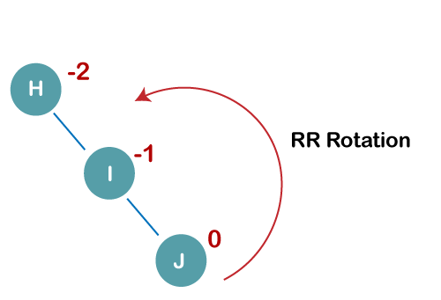
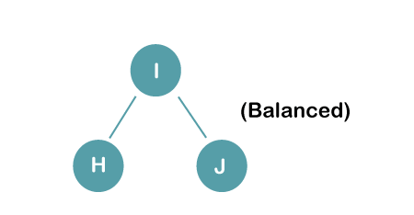
AVL TREE CONSTRUCTION
Q: Construct an AVL tree having the following elements H, I, J, B, A, E, C, F, D, G, K, L
1. Insert H, I, J

Slide 67
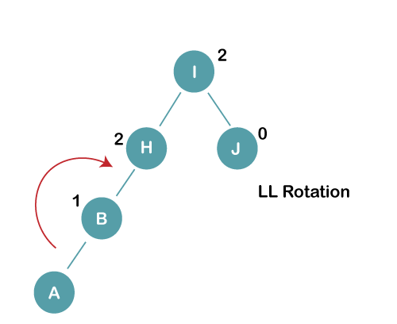
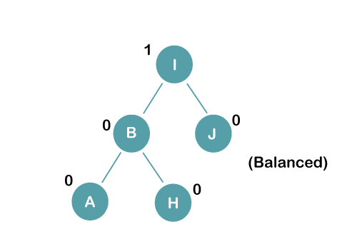
AVL TREE CONSTRUCTION
2. Insert B, A

Slide 68
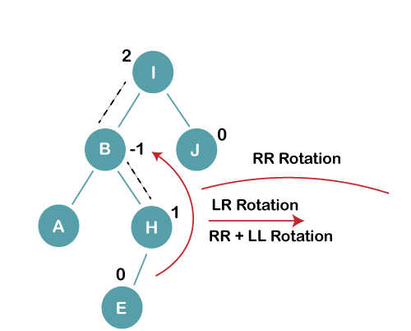
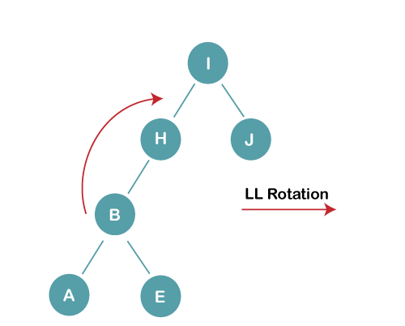
AVL TREE CONSTRUCTION
3. Insert E
a) We first perform RR rotation on node B
b) perform LL rotation on the node I

Slide 69
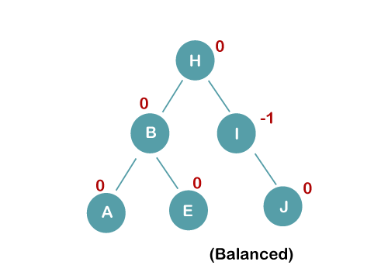
AVL TREE CONSTRUCTION
3. Insert E
b) perform LL rotation on the node I

Slide 70
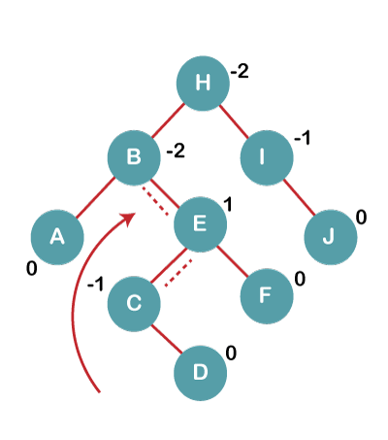
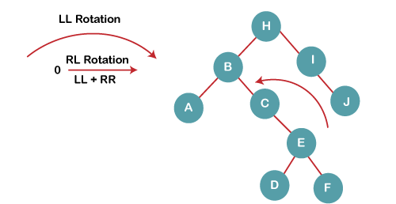
AVL TREE CONSTRUCTION
4. Insert C, F, D
a) We first perform LL rotation on node E
The resultant tree after LL rotation is:

Slide 71
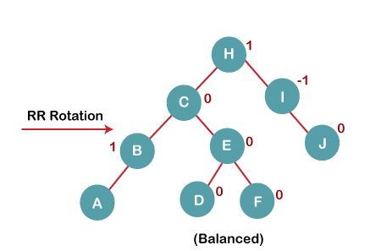
AVL TREE CONSTRUCTION
4. Insert C, F, D
b) We then perform RR rotation on node B
The resultant balanced tree after RR rotation is:

Slide 72
To Be DISCUSSED
Threaded binary tree
In-order traversal of in-order threaded binary tree.
AVL Trees
Red Black Tree
Indexing and Multiway Trees
Search tree
B-Tree, B+Tree
Splay Tree
Trie Tree

Slide 73
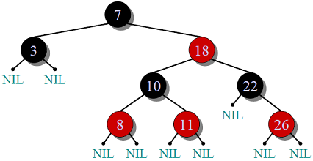
What is Red Black Tree
Red-Black Tree is a self-balancing Binary Search Tree (BST) where every node follows following rules:
1) Every node has a color either red or black.
2) Root of tree is always black.
3) There are no two adjacent red nodes (A red node cannot have a red parent or red child).
4) Every path from root to a NULL node has same number of black nodes.

Slide 74
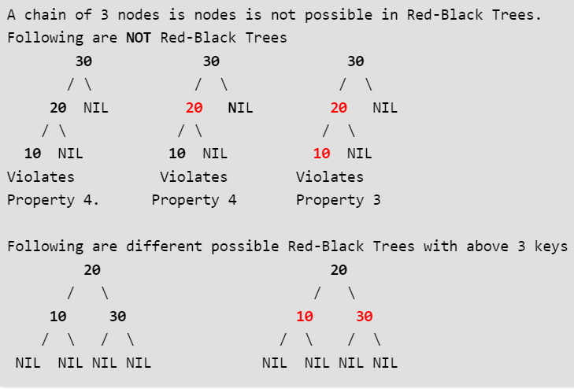
Examples

Slide 75
Why Red Black Tree
The AVL trees are more balanced compared to Red Black Trees, but they may cause more rotations during insertion and deletion.
So if your application involves many frequent insertions and deletions, then Red Black trees should be preferred.
And if the insertions and deletions are less frequent and search is more frequent operation, then AVL tree should be preferred over Red Black Tree.

Slide 76
Red Black Tree Insertion
In AVL tree insertion, we used rotation as a tool to do balancing after insertion caused imbalance. In Red-Black tree, we use two tools to do balancing.
1)Recoloring 2) Rotation
We try recoloring first, if recoloring doesn’t work, then we go for rotation.
The algorithms has mainly two cases depending upon the color of uncle. If uncle is red, we do recoloring. If uncle is black, we do rotations and/or recoloring.
Color of a NULL node is considered as BLACK.

Slide 77
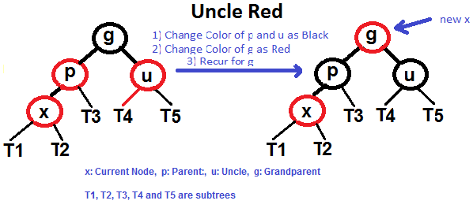
Insertion (contd..)
Let x be the newly inserted node.
1) Perform standard BST insertion and make the color of newly inserted nodes as RED.
2) If x is root, change color of x as BLACK
3) Do following if color of x’s parent is not BLACK or x is not root. a) If x’s uncle is RED (Grand parent must have been black ) ……..(i) Change color of parent and uncle as BLACK. ……..(ii) color of grand parent as RED. ……..(iii) Change x = x’s grandparent, repeat steps 2 and 3 for new x.

Slide 78
Insertion (contd..)
Let x be the newly inserted node.
b) If x’s uncle is BLACK, then there can be four configurations for x, x’s parent (p) and x’s grandparent (g) (This is similar to AVL Tree) ……..i) Left Left Case (p is left child of g and x is left child of p) ……..ii) Left Right Case (p is left child of g and x is right child of p) ……..iii) Right Right Case (Mirror of case a) ……..iv) Right Left Case (Mirror of case c)

Slide 79
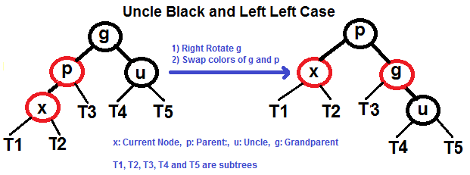
Insertion (contd..)
Left Left Case (See g, p and x)

Slide 80
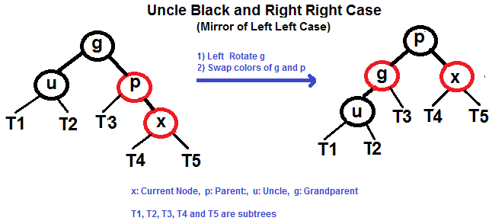
Insertion (contd..)
Right Right Case (See g, p and x)

Slide 81
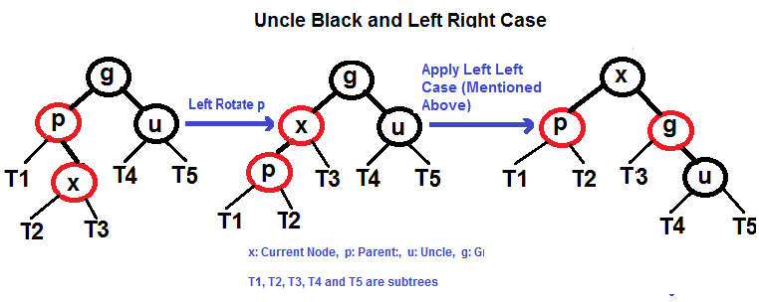
Insertion (contd..)
Left Right Case (See g, p and x)

Slide 82
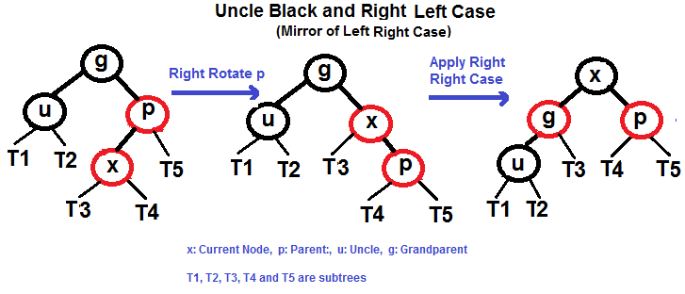
Insertion (contd..)
Right Left Case (See g, p and x)

Slide 83
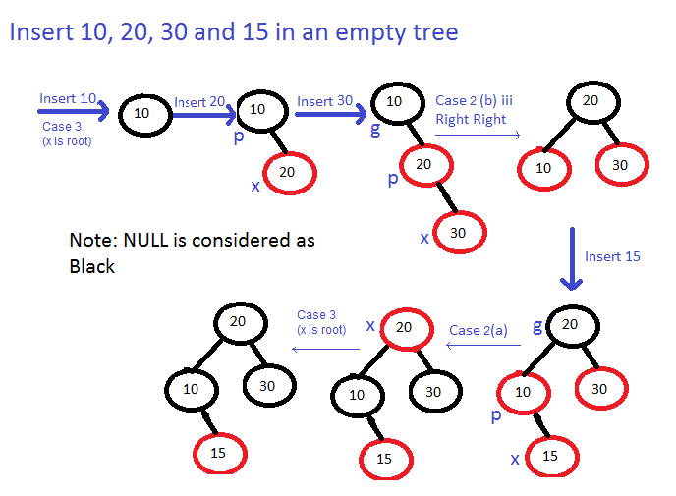
Example of Insertion

Slide 84
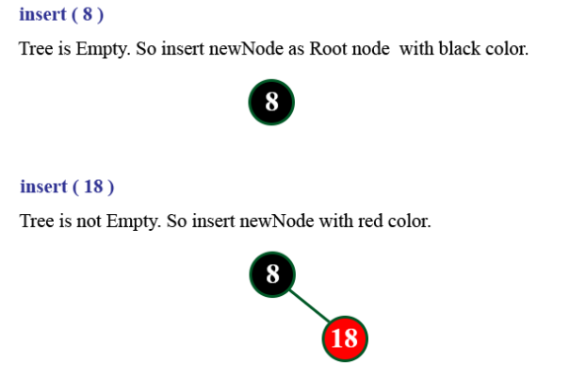
Example
Create red black tree for following data
8,18,5,15,17,25,40 ,80

Slide 85
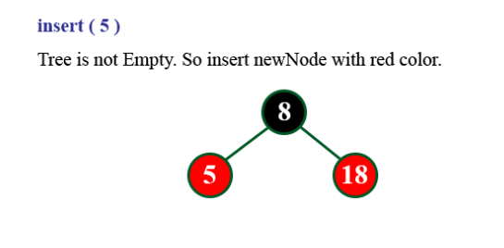

Slide 86
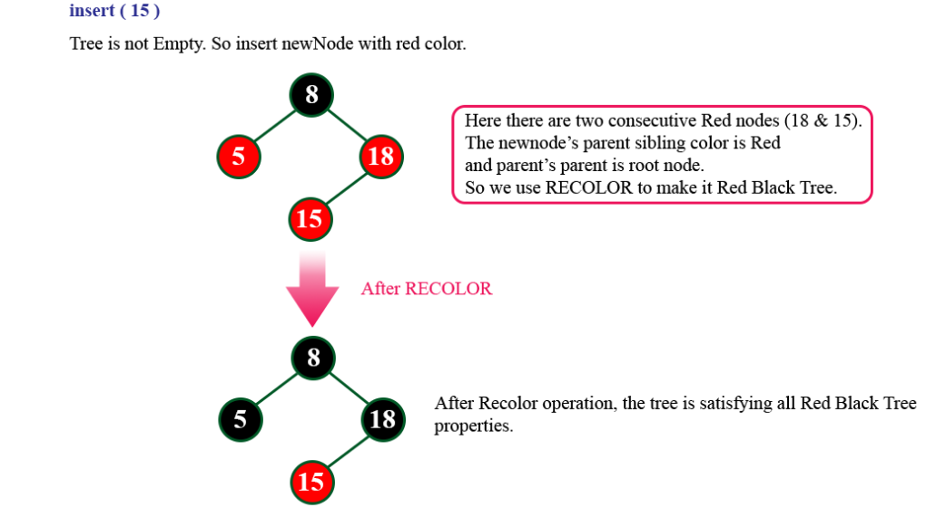

Slide 87
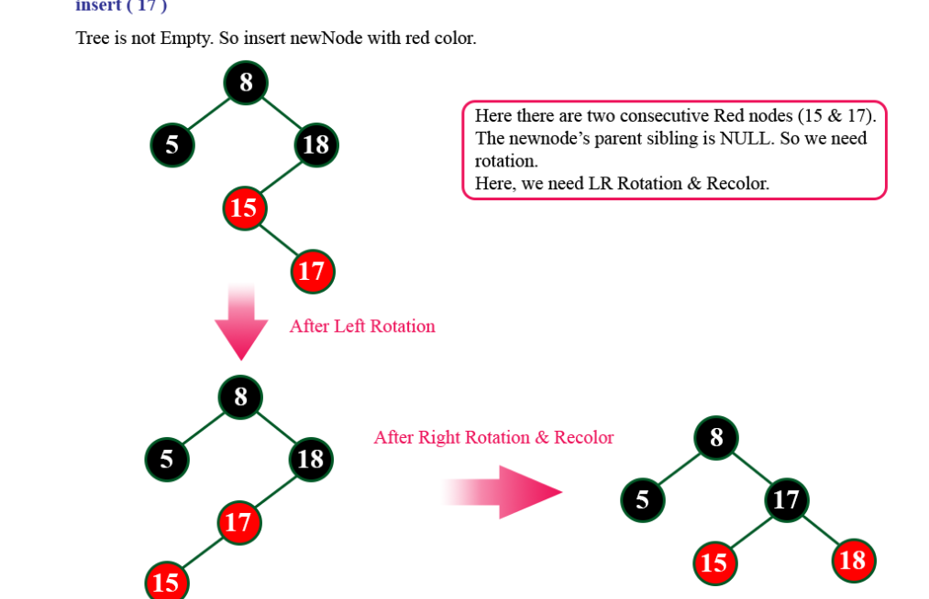

Slide 88
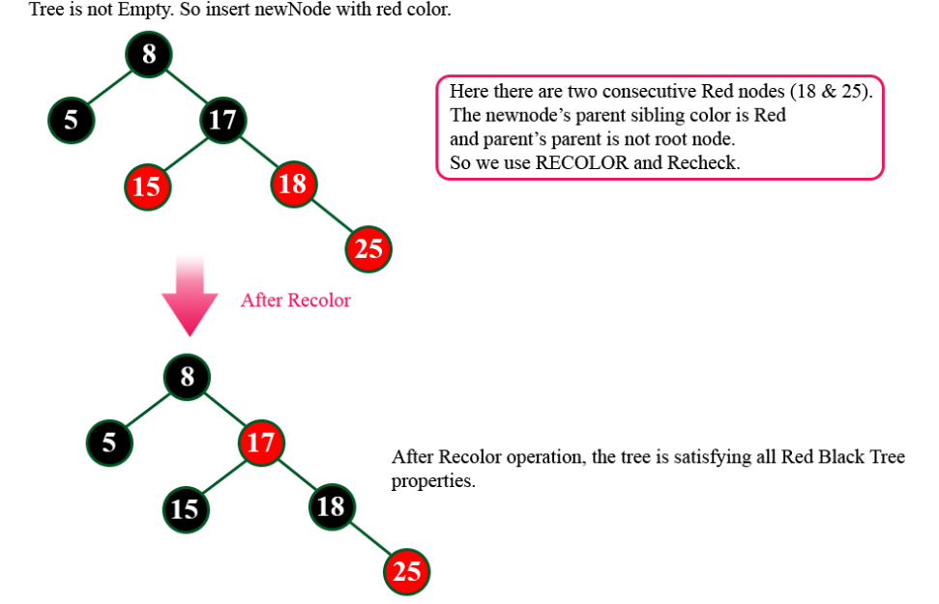
Insert 25

Slide 89
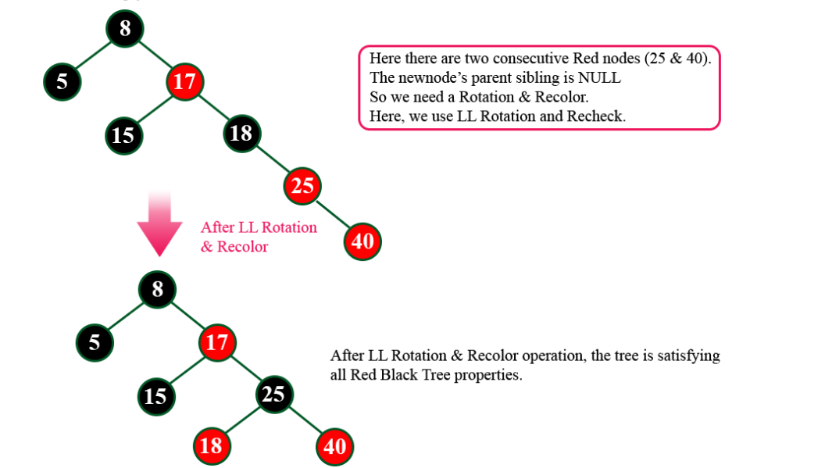
Insert 40

Slide 90
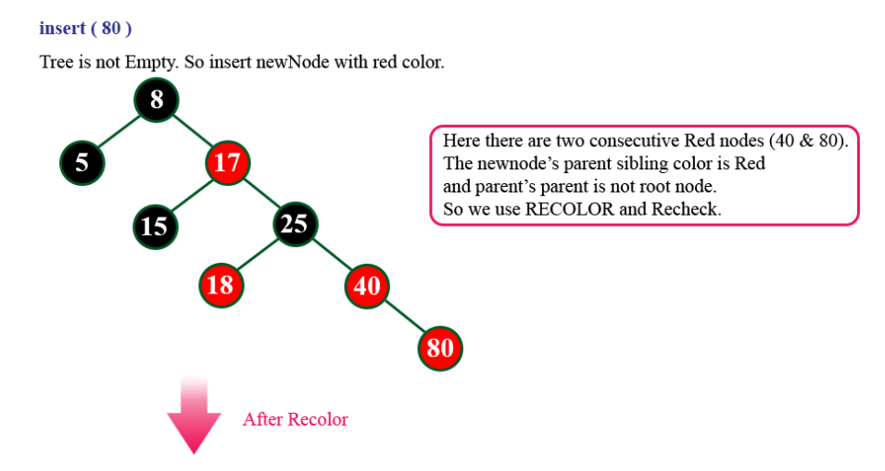

Slide 91
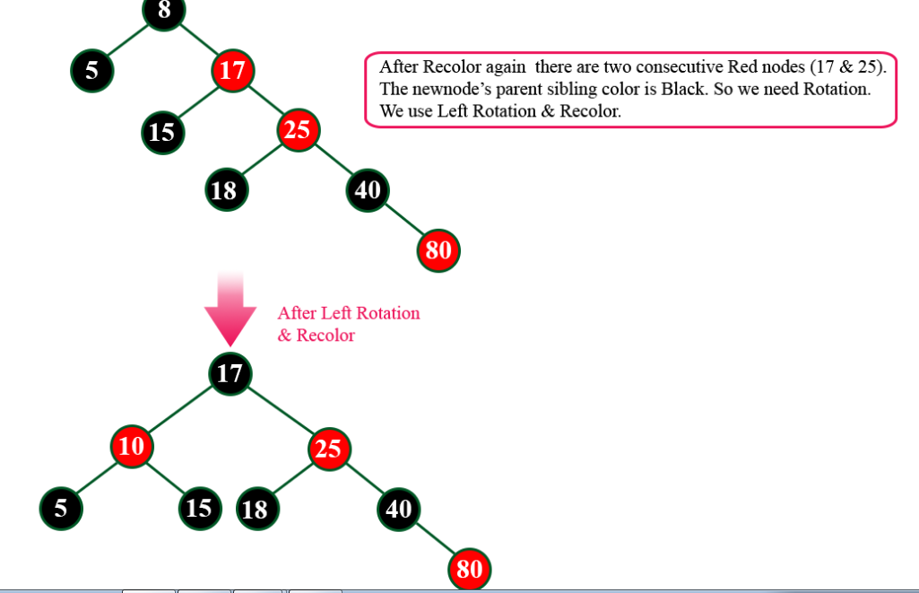
8

Slide 92
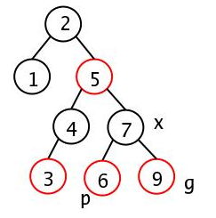
Exercise
Insert 2, 1, 4, 5, 9, 3, 6, 7 into a Red Black Tree

Slide 93
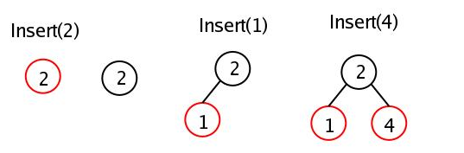
Solution to Exercise

Slide 94
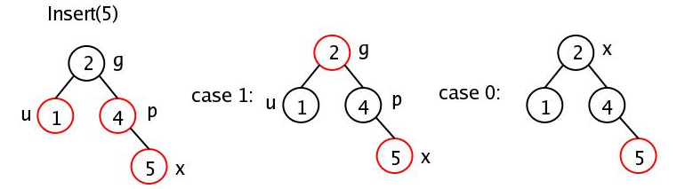

Slide 95
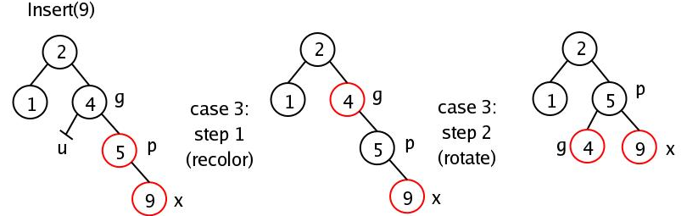

Slide 96
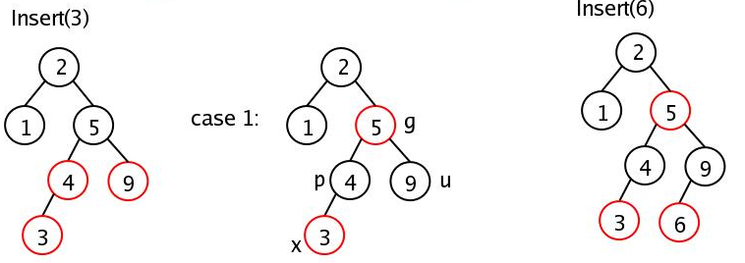

Slide 97
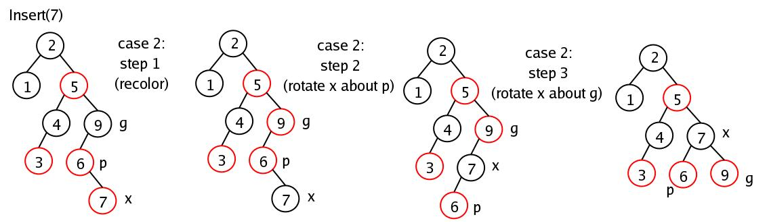

Slide 98
To Be DISCUSSED
Threaded binary tree
In-order traversal of in-order threaded binary tree.
AVL Trees
Red Black Tree
Indexing and Multiway Search Trees
B-Tree, B+Tree
Splay Tree
Trie Tree

Slide 99
INDEXING
Data is read from the disk block wise. Searching a record from database may require several block access which will be slow. So we need appropriate data structure to reduce the number of block accesses. This can be done with help of indexing
Indexing is a table which is consist of two columns – key, block address
Indexing is also further divided into two types
1)Dense Index
2)Sparse Index.

Slide 100
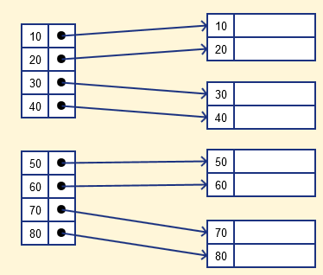
Dense iNDEX
In a dense index, a record is created for every search key valued in the database. This helps you to search faster but needs more space to store index records. In this Indexing, method records contain search key value and address of block containing the real record on the disk.

Slide 101
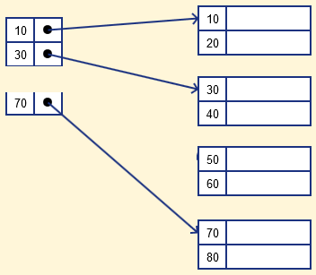
SPARSE iNDEX
It is an index record that appears for only some of the values in the file. Sparse Index helps you to resolve the issues of dense Indexing in DBMS.

Slide 102
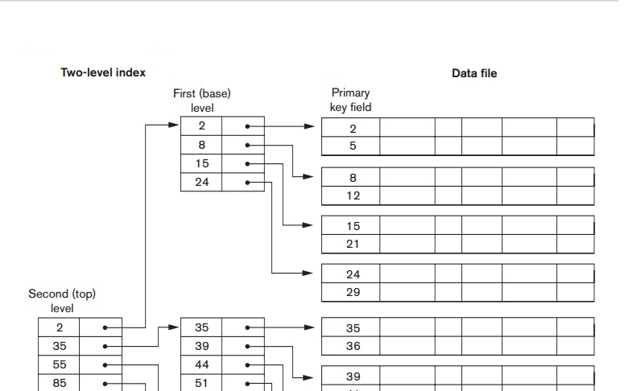
MULTi LEVEL INDEXING
Multilevel Indexing in Database is created when a primary index does not fit in memory.

Slide 103
B Trees- introduction
Binary Search Trees + Self Balancing Property = AVL Trees
Red Black Trees
Store more than one value
in single node
Have more than two children
per node
Used for Implementing
multilevel indexing
To store extremely large amount
of data self balancing property
will not be enough to prevent
huge increase in the tree height

Slide 104
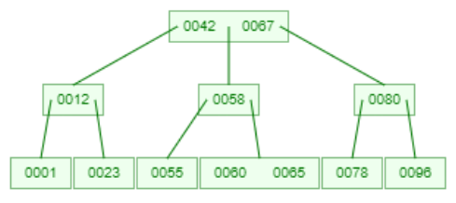
B-TREES
Store mode than one value in single node
Have more than 2 children per node
B-Tree of order m can have ‘m’ children and at most ‘m-1’ key values
For each node x, the keys are stored in increasing order.
BST property holds-
operations on BST are applicable
efficient on large data

Slide 105
B-TREES PROPERTIES
For a tree to be called as valid B-Tree of order-m it should satisfy following additional property to that of ordering
Every internal node contains at most m children and m - 1 keys along with a pointer to each child and address of record.
Every node in a B-Tree except the root node and the leaf node contain at least m/2 children.
The root nodes must have at least 2 children and 1 key
All leaf nodes must be at the same level

Slide 106
B-TREES Insert Operation
If the tree is empty, allocate a root node and insert the key
Update the allowed number of keys in the node
Search the appropriate node for insertion
If the node is full, follow the steps below
Insert the elements in increasing order
Now, there are elements greater than its limit. So, split at the median
Push the median key upwards and make the left keys as a left child and the right keys as a right child
If the node is not full, follow the steps below
Insert the node in increasing order.

Slide 107
B-TREES INSERTION VISUALIZATION
https://www.cs.usfca.edu/~galles/visualization/BTree.html

Slide 108
B-TREES TRAVERSAL(in-order)
1
12
23
42
55
58
60
65
67
78
80
96

Slide 109
B-TREES SEARCH OPERATION
Searching for an element in a B-tree is the generalized form of searching an element in BST.
Starting from the root node, compare k with the first key of the node.
If k = the first key of the node, return the node and the index.
If k < the first key of the root node, search the left child of this key recursively.
If there is more than one key in the current node and k > the first key, compare k with the next key in the node.
If k < next key, search the left child of this key (ie. k lies in between the first and the second keys).
Else, search the right child of the key.
Repeat steps 1 to 3 until the leaf is reached.

Slide 110

B TREES
Block address of record with key
Tree Pointer
Leaf Pointer

Slide 111


B+ TREES
The data pointers are present only at the leaf nodes on a B+ tree whereas the data pointers are present in the internal, leaf or root nodes on a B-tree.
The leaves are not connected with each other on a B-tree whereas they are connected on a B+ tree.

Slide 112
B+ TREES (contd..)
99% of database management systems use B+trees for indexing.
This is because the B+tree holds no block adresss in the internal nodes. This maximizes the number of keys stored in a node thereby minimizing the number of levels needed in a tree. Smaller tree depth invariably means faster search.
Leaf nodes in a B+tree are linked together making range search operations efficient and quick

Slide 113
To Be DISCUSSED
Threaded binary tree
In-order traversal of in-order threaded binary tree.
AVL Trees
Red Black Tree
Indexing and Multiway Search Trees
B-Tree, B+Tree
Splay Tree
Trie Tree- Self Study

Slide 114
SPLAY TREES
Splay tree is also self-balancing BST.
The main idea of splay tree is to bring the recently accessed item to root of the tree, this makes the recently searched item to be accessible in O(1) time if accessed again.
The idea is to use locality of reference (In a typical application, 80% of the access are to 20% of the items). Imagine a situation where we have millions or billions of keys and only few of them are accessed frequently, which is very likely in many practical applications.
All splay tree operations run in O(log n) time on average, where n is the number of entries in the tree

Slide 115

SEARCH IN SPLAY TREES
The search operation in Splay tree does the standard BST search
In addition to search, it also splays (move a node to the root).
If the search is successful, then the node that is found is splayed and becomes the new root.
Else the last node accessed prior to reaching the NULL is splayed and becomes the new root.
There are following cases for the node being accessed.
Node is root: We simply return the root, don’t do anything else as the accessed node is already root.
Zig: Node is child of root (the node has no grandparent)

Slide 116

SEARCH IN SPLAY TREES
Node has both parent and grandparent:
3.a) Zig-Zig and Zag-Zag Node is left child of parent and parent is also left child of grand parent OR node is right child of its parent and parent is also right child of grand parent

Slide 117

SEARCH IN SPLAY TREES
Node has both parent and grandparent:
3.b) Zig-Zag and Zag-Zig: Node is right child of parent and parent is right left of grand parent OR node is left child of its parent and parent is right child of grand parent

Slide 118

Example

